Slide 1
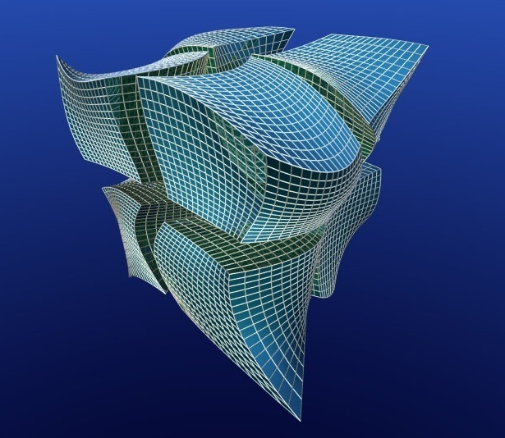
Understanding the Inventor B-Rep API
Presenter
Developer Technical Services

Slide 2
Agenda
BRep object model
Accessing the BRep
Examples
Transient Geometry Object
Geometry Evaluators
Exporting Inventor Geometry
TransientBRep Object

Slide 3
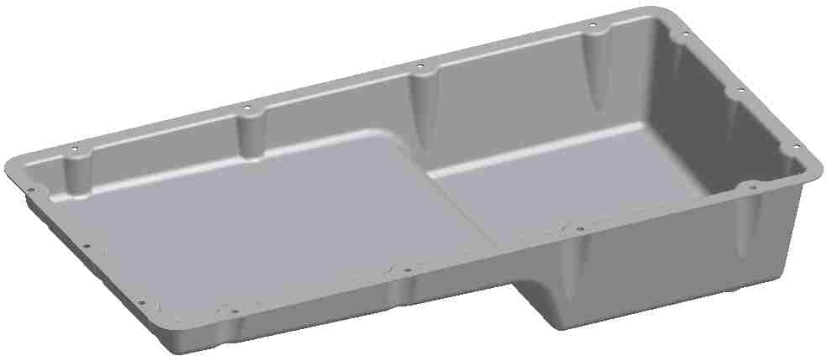
Understanding Solids (B-Rep)
The B-Rep or “Boundary Representation” provides a complete geometric description of a solid model.
It is ignorant of the methods used to create the solid and has no knowledge of the features used to create it.
It provides access to both the topology and the geometry of the solid model.

Slide 4
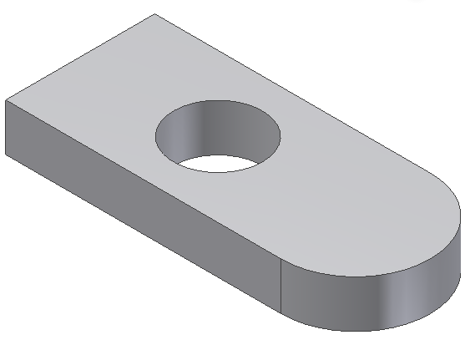
Solids (B-Rep)
SurfaceBody

Slide 5
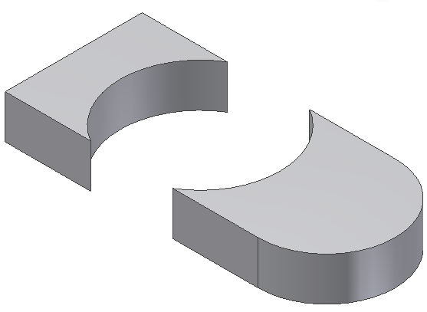
Solids (B-Rep)
FaceShell

Slide 6
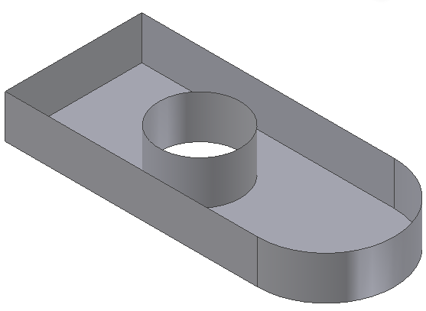
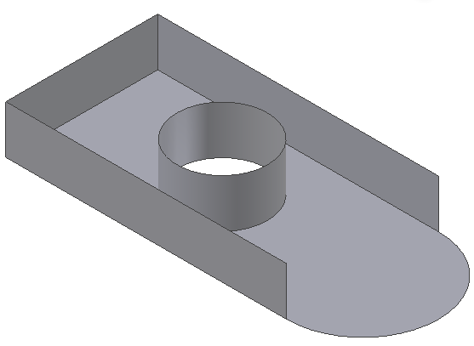
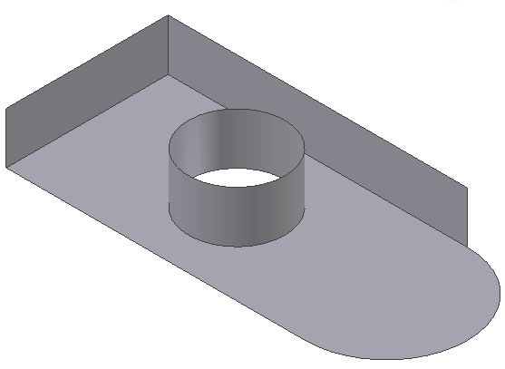
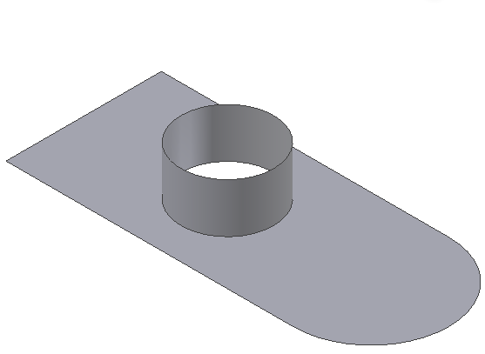
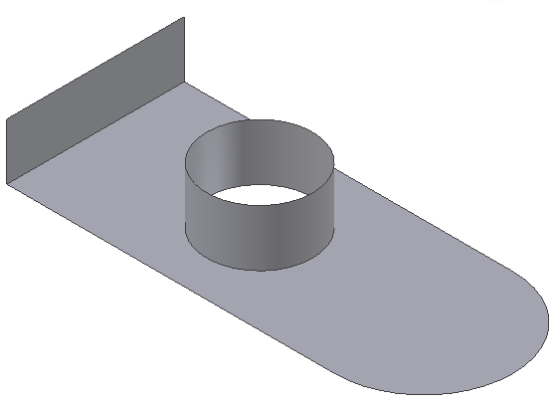
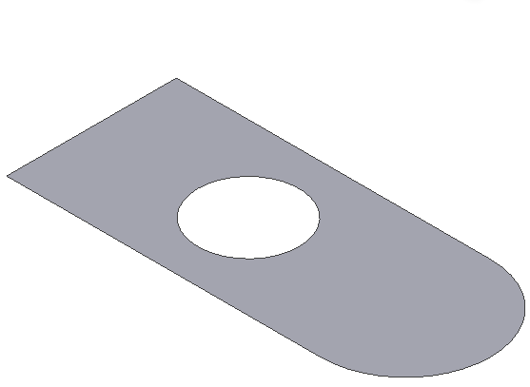
Solids (B-Rep)
Face

Slide 7
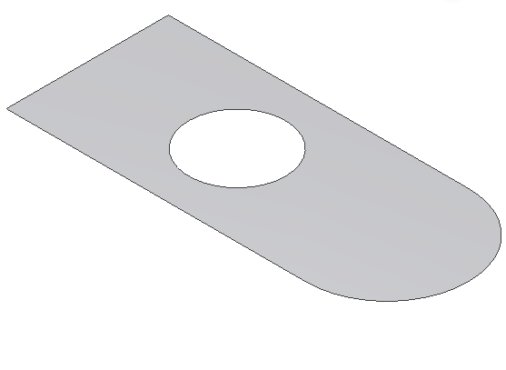
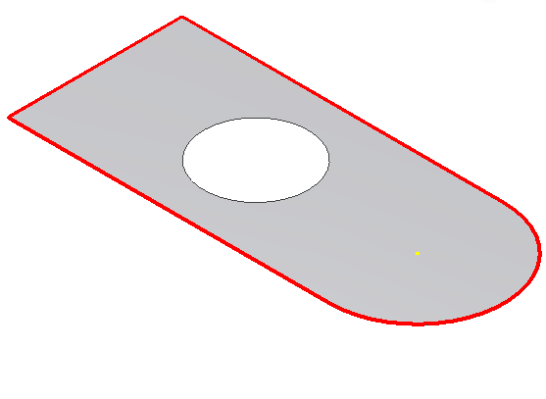
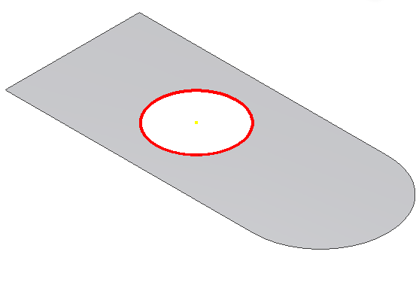
Solids (B-Rep)
EdgeLoop

Slide 8
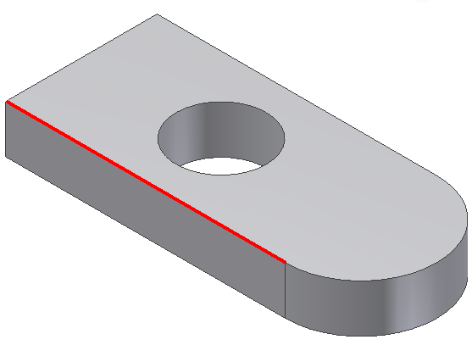
Solids (B-Rep)
Edge

Slide 9
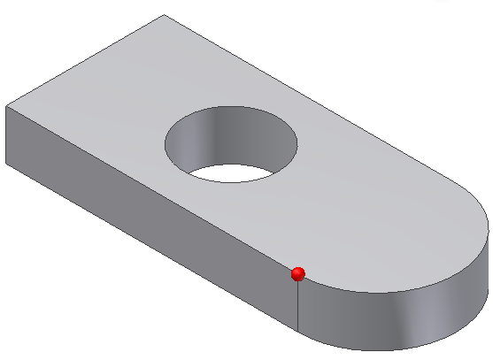
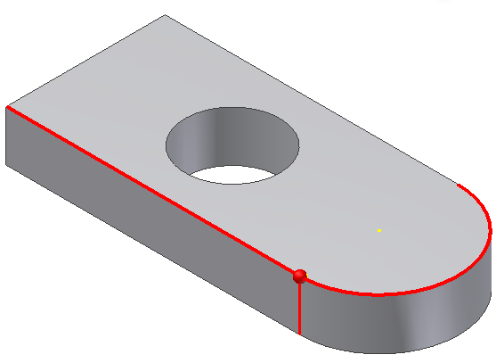
Solids (B-Rep)
Vertex

Slide 10
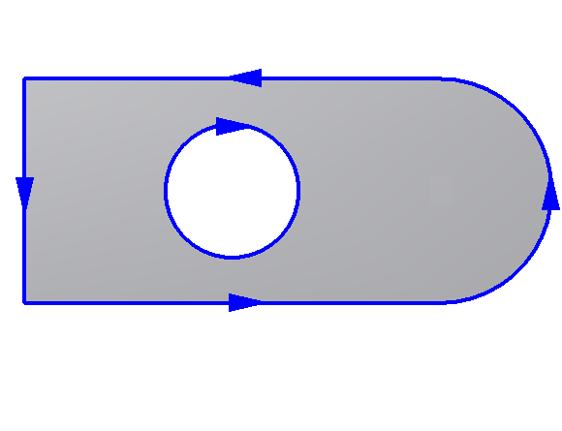
Solids (B-Rep)
EdgeUse
Notes:
An Edge object is similar but defines only the connectivity between two adjacent faces, so typically represents only part of an EdgeLoop. An Edge object is shared between faces, unlike an EdgeUse object. A face has its own set of EdgeUse objects, which apply only to that face. They are defined in terms of the 2D parameter space of that face. Typically, there are two EdgeUse objects for each Edge Object. Edge objects are shared between faces but EdgeUse objects are not. They contain information specific to a face, including a conceptual flow direction for the face edges, useful in traversing faces.
Number of EdgeUses can be seen as the number of Faces sharing this specific edge.

Slide 11
B-Rep Access
For Inventor 2009 and previous the SurfaceBodies collection will always either contain 0 or 1 SurfaceBody objects.
From 2010 it is no longer the case, multi-bodies can reside within a single, so SurfaceBodies can go from 0 to N.
Accessing B-Rep entities:
Traversing the B-Rep structure.
From existing features. (Faces, EndFaces, StartFaces, SideFaces)
Near a specified point. (LocateUsingPoint)
Intersected by a specified vector. (FindUsingRay)
Selected by the end-user.
Querying based on previously assigned attributes.
Notes:
For more information about working with multi-bodies and the API refer to Module 13 “Part Document Advanced”

Slide 12
B-Rep Traversal - Example
Public Sub CountPlanarFacesInEachShell()
Dim oPartDoc As PartDocument
oPartDoc = _InvApplication.ActiveDocument
' Iterate through the FaceShell objects.
Dim iShellCount As Integer
Dim oShell As FaceShell
For Each oShell In oPartDoc.ComponentDefinition.SurfaceBodies.Item(1).FaceShells
iShellCount = iShellCount + 1
' Iterate over the faces in this shell.
Dim iPlanarFaceCount As Integer
iPlanarFaceCount = 0
Dim oFace As Face
For Each oFace In oShell.Faces
' Check to see if the face is planar.
If oFace.SurfaceType = SurfaceTypeEnum.kPlaneSurface Then
iPlanarFaceCount = iPlanarFaceCount + 1
End If
Next
Debug.Print("FaceShell " & iShellCount & _
" has " & iPlanarFaceCount & " planar faces.")
Next
End Sub
Notes:
'/////////////////////////////////////////////////////////////////////////////////////////////////////////////
'// Sample
'//
'// Use: BRep Traversal. Counts number of planar faces in each FaceShell
'/////////////////////////////////////////////////////////////////////////////////////////////////////////////
Public Sub BRepTraversal()
Dim oPartDoc As PartDocument
oPartDoc = _InvApplication.ActiveDocument
' Iterate through the FaceShell objects.
Dim iShellCount As Integer
Dim oShell As FaceShell
For Each oShell In oPartDoc.ComponentDefinition.SurfaceBodies.Item(1).FaceShells
iShellCount = iShellCount + 1
' Iterate over the faces in this shell.
Dim iPlanarFaceCount As Integer
iPlanarFaceCount = 0
Dim oFace As Face
For Each oFace In oShell.Faces
' Check to see if the face is planar.
If oFace.SurfaceType = SurfaceTypeEnum.kPlaneSurface Then
iPlanarFaceCount = iPlanarFaceCount + 1
End If
Next
Debug.Print("FaceShell[" & iShellCount & "] has " & iPlanarFaceCount & " planar faces.")
Next
End Sub

Slide 13
Find At Point - Example
Public Sub GetFaceAtPoint()
Dim oPartDoc As PartDocument
oPartDoc = _InvApplication.ActiveDocument
Dim oBody As SurfaceBody
oBody = oPartDoc.ComponentDefinition.SurfaceBodies.Item(1)
Dim oPoint As Point
oPoint = _InvApplication.TransientGeometry.CreatePoint(0, 0, 0)
Dim oFace As Face
Try
‘ find a face which the point locates on
oFace = oBody.LocateUsingPoint(ObjectTypeEnum.kFaceObject, oPoint)
MsgBox("Found face with area " & oFace.Evaluator.Area & " cm^2")
Catch
MsgBox("No face at the specified point.")
End Try
End Sub
Notes:
'/////////////////////////////////////////////////////////////////////////////////////////////////////////////
'// Sample
'//
'// Use: Get Face at specified point
'/////////////////////////////////////////////////////////////////////////////////////////////////////////////
Public Sub GetFaceAtPoint()
Dim oPartDoc As PartDocument
oPartDoc = _InvApplication.ActiveDocument
Dim oBody As SurfaceBody
oBody = oPartDoc.ComponentDefinition.SurfaceBodies.Item(1)
Dim oPoint As Point
oPoint = _InvApplication.TransientGeometry.CreatePoint(0, 0, 0)
Dim oFace As Face
Try
oFace = oBody.LocateUsingPoint(ObjectTypeEnum.kFaceObject, oPoint)
MsgBox("Found face with area " & oFace.Evaluator.Area & " cm^2")
Catch
MsgBox(“No face at the specified point.")
End Try
End Sub

Slide 14
Find Along Ray - Example
Public Sub FindUsingRay()
Dim oPartDoc As PartDocument
oPartDoc = _InvApplication.ActiveDocument
Dim oBody As SurfaceBody
oBody = oPartDoc.ComponentDefinition.SurfaceBodies.Item(1)
Dim oTg As TransientGeometry
oTg = _InvApplication.TransientGeometry
Dim oFoundEnts As ObjectsEnumerator = Nothing
Dim oLocPoints As ObjectsEnumerator = Nothing
‘ find the object by a ray
Call oBody.FindUsingRay(oTg.CreatePoint(-5, 0, 0), _
oTg.CreateUnitVector(1, 0, 0), 0.00001, _
oFoundEnts, oLocPoints, True)
If oFoundEnts.Count > 0 Then
MsgBox("Found " & oFoundEnts.Count & " Entities")
Else
MsgBox("No entity along the specified ray.")
End If
End Sub
Notes:
'/////////////////////////////////////////////////////////////////////////////////////////////////////////////
'// Sample
'//
'// Use: Find using ray sample
'/////////////////////////////////////////////////////////////////////////////////////////////////////////////
Public Sub FindUsingRay()
Dim oPartDoc As PartDocument
oPartDoc = _InvApplication.ActiveDocument
Dim oBody As SurfaceBody
oBody = oPartDoc.ComponentDefinition.SurfaceBodies.Item(1)
Dim oTg As TransientGeometry
oTg = _InvApplication.TransientGeometry
Dim oFoundEnts As ObjectsEnumerator = Nothing
Dim oLocPoints As ObjectsEnumerator = Nothing
Call oBody.FindUsingRay(oTg.CreatePoint(-5, 0, 0), _
oTg.CreateUnitVector(1, 0, 0), 0.00001, _
oFoundEnts, oLocPoints, True)
If oFoundEnts.Count > 0 Then
MsgBox("Found " & oFoundEnts.Count & " Entities")
Else
MsgBox("No entity along the specified ray.")
End If
End Sub

Slide 15
B-Rep Access From a Feature
Some features support properties to directly access related B-Rep entities.
All features:
Faces, SurfaceBody
ExtrudeFeature, RevolveFeature, SweepFeature, LoftFeature, HoleFeature:
EndFaces, StartFaces, SideFaces

Slide 16
Transient Geometry
Geometry objects are “snapshots” of the topology. They can be edited but it does not affect the original topology they were obtained from.
All surfaces are unbounded. Line and Line2d are infinite. LineSegment and LineSegment2d are bounded.

Slide 17
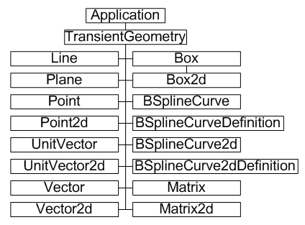
Transient Geometry Math Objects
The TransientGeometry object allows you to create some mathematical objects that can be used as input for methods and properties and also used internally for your own calculations.

Slide 18
Vectors
Vectors define a direction and magnitude.
A Vector can be used to define the movement of the part.
A UnitVector defines a direction. Its magnitude is always 1.

Slide 19
Vector Functions
Compare two Vectors: AngleTo, IsEqualTo, IsParallelTo, IsPerpendicularTo, …
Manipulate a Vector: AddVector, Normalize, SubtractVector, TransformBy, ScaleBy, …
Analyze:
CrossProduct
DotProduct
Length

Slide 20
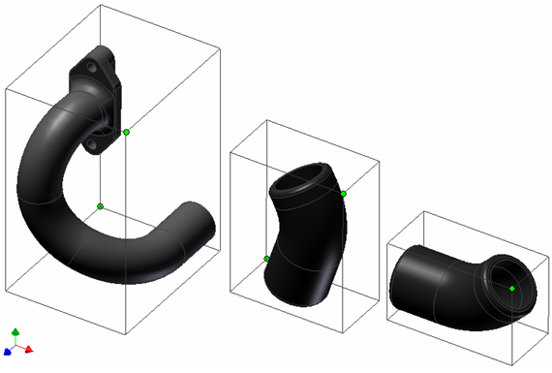
Boxes
Exists in 2D: Box2d object and 3D: Box object
Two Points that define the minimum and maximum corners of a box.
Typically used for bounding boxes.
Inventor’s bounding boxes are always axially aligned.
Methods: Contains, Expand (dist.), Extend (Point)

Slide 21
Lab: Using Transient Objects
Through UI: Create a 2D Sketch that contains a line and a circle.
Use transient geometry objects to find intersection points between the line and the circle:
1. When the line physically intersects the circle
2. When the line geometric extend intersects the circle
Print the coordinates of intersection to the output window.

Slide 22
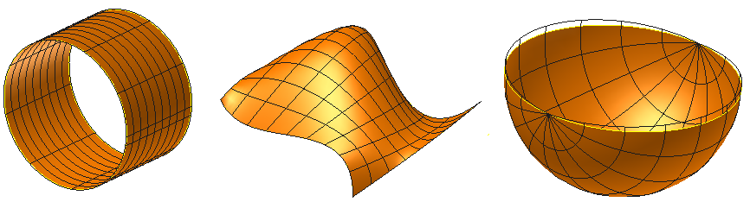
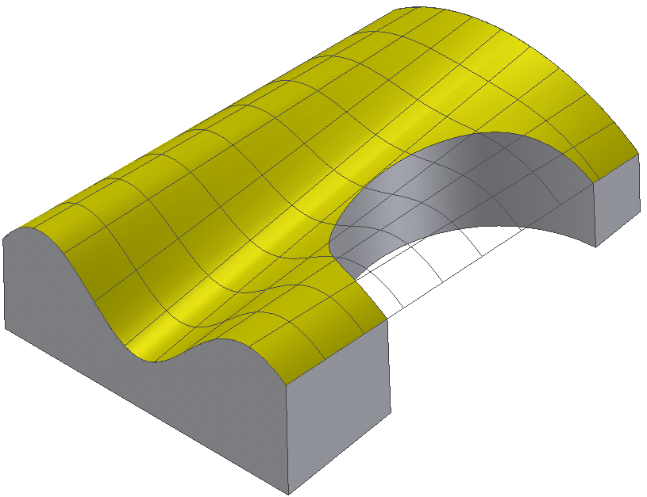
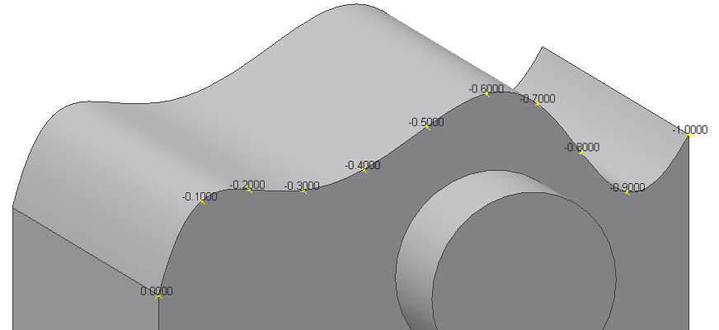
Geometry Evaluators
Surface and Curve evaluator objects provide general geometric queries for all faces and curves.
Curvatures
Normals
Parameter space / Model space conversions
Tangents
Parameter Range
Area (Face)
Lengths (Curves)
Derivatives

Slide 23
Evaluator - Example
' Find the first face whose normal is in the same direction as the input vector.
Public Function FindFace(ByVal oBody As SurfaceBody, ByVal CheckVector As UnitVector) _
As Face
FindFace = Nothing
Dim oFace As Face
For Each oFace In oBody.Faces
Dim oSurfEval As SurfaceEvaluator
oSurfEval = oFace.Evaluator
‘ get param range
Dim oParamRange As Box2d
oParamRange = oSurfEval.ParamRangeRect
Dim adParams(1) As Double
adParams(0) = (oParamRange.MinPoint.X + oParamRange.MaxPoint.X) / 2
adParams(1) = (oParamRange.MinPoint.Y + oParamRange.MaxPoint.Y) / 2
‘ get the normal at middle param
Dim adNormals(2) As Double
Call oSurfEval.GetNormal(adParams, adNormals)
‘ calculate the angle from the normal to a check vector
Dim oTestVector As UnitVector
oTestVector = _InvApplication.TransientGeometry.CreateUnitVector( _
adNormals(0), adNormals(1), adNormals(2))
If CheckVector.AngleTo(oTestVector) < 0.0001 Then
FindFace = oFace
Exit Function
End If
Next
End Function
Notes:
'/////////////////////////////////////////////////////////////////////////////////////////////////////////////
'// Sample
'//
'// Use: Geometry Evaluator. Draws selected surface normals
'/////////////////////////////////////////////////////////////////////////////////////////////////////////////
Public Sub FaceParametricNormals()
Dim oFace As Face
oFace = _InvApplication.ActiveDocument.SelectSet(1)
Dim oEvaluator As SurfaceEvaluator
oEvaluator = oFace.Evaluator
Dim oParamRBox As Box2d
oParamRBox = oEvaluator.ParamRangeRect
Dim uStep As Double
Dim vStep As Double
uStep = System.Math.Round((oParamRBox.MaxPoint.X - oParamRBox.MinPoint.X) / 9, 10)
vStep = System.Math.Round((oParamRBox.MaxPoint.Y - oParamRBox.MinPoint.Y) / 9, 10)
Dim u As Long
Dim v As Long
For u = 0 To 9
For v = 0 To 9
Dim params(1) As Double
params(0) = oParamRBox.MinPoint.X + u * uStep
params(1) = oParamRBox.MinPoint.Y + v * vStep
Dim normal(2) As Double
Call oEvaluator.GetNormal(params, normal)
Dim startPoint(2) As Double
Call oEvaluator.GetPointAtParam(params, startPoint)
Dim endPoint(2) As Double
endPoint(0) = startPoint(0) + normal(0)
endPoint(1) = startPoint(1) + normal(1)
endPoint(2) = startPoint(2) + normal(2)
'See client Graphics module
ClientGraphicUtility.DrawLineTestDb(startPoint, endPoint)
Next
Next
End Sub

Slide 24
Lab: Using CurveEvaluator
Write a procedure that takes as input an Edge object from your model and access its Evaluator.
Print out the following properties for the edge:
The curve length
The coordinates of the middle point
The curvature, tangent and first derivatives at the middle point
Extra: you can add a workpoint to visualize the position of this middle point on the model and a workaxis for the tangent (Check the Help Files to choose which “Add…” method to use).

Slide 25
Exporting Inventor Geometry
The SurfaceBody object and the BRep entities allow to export BRep data from an Inventor model.
The following methods can be used for this purpose:
CalculateFacets
GetExistingFacets
CalculateStrokes
GetExistingStrokes
The accuracy of the output can be specified through the Tolerance argument of the CalculateFacets / CalculateStrokes methods.
Notes:
See “GenerateFacets” sample in Samples Module 04 VB.Net.

Slide 26
TransientBRep Object
The TransientBRep object is used to create and manipulate B-Rep objects within a transient space.
B-Rep objects that exist within this transient space are not displayed, saved, or transacted by Inventor. It’s used to perform B-Rep calculations outside the user context of Inventor.
TransientBRep Methods:
Copy Method: creates a copy of the input SurfaceBody.
Various Create**** Methods: Generate Brep primitives.
DoBoolean Method: Boolean operation between BRep bodies
Transform Method: Transform a body.
Notes:
'Create a non parametric Feature based on a Transient Brep object
Public Sub CreateBRep()
' Create a new part document, using the default part template.
Dim oPartDoc As PartDocument
Set oPartDoc = ThisApplication.Documents.Add(kPartDocumentObject, _
ThisApplication.FileManager.GetTemplateFile(kPartDocumentObject))
' Set a reference to the component definition.
Dim oCompDef As PartComponentDefinition
Set oCompDef = oPartDoc.ComponentDefinition
' Set a reference to the TransientBRep object.
Dim oTransientBRep As TransientBRep
Set oTransientBRep = ThisApplication.TransientBRep
' Create a range box that will define the extents of a block.
Dim oBox As Box
Set oBox = ThisApplication.TransientGeometry.CreateBox
' Expand in all directions by 1 cm.
oBox.Expand 1
' Create the block.
Dim oBody As SurfaceBody
Set oBody = oTransientBRep.CreateSolidBlock(oBox)
' Create bottom and top points for a cylinder.
Dim oBottomPt As Point
Set oBottomPt = ThisApplication.TransientGeometry.CreatePoint(0, 1, 0)
Dim oTopPt As Point
Set oTopPt = ThisApplication.TransientGeometry.CreatePoint(0, 3, 0)
' Create the cylinder body.
Dim oCylinder As SurfaceBody
Set oCylinder = oTransientBRep.CreateSolidCylinderCone(oBottomPt, oTopPt, 0.5, 0.5, 0.5)
' Boolean the bodies; "oBody" will return the result
Call oTransientBRep.DoBoolean(oBody, oCylinder, kBooleanTypeUnion)
' Create a base feature with the result body.
Dim oBaseFeature As NonParametricBaseFeature
Set oBaseFeature = oCompDef.Features.NonParametricBaseFeatures.Add(oBody)
End Sub

Slide 27
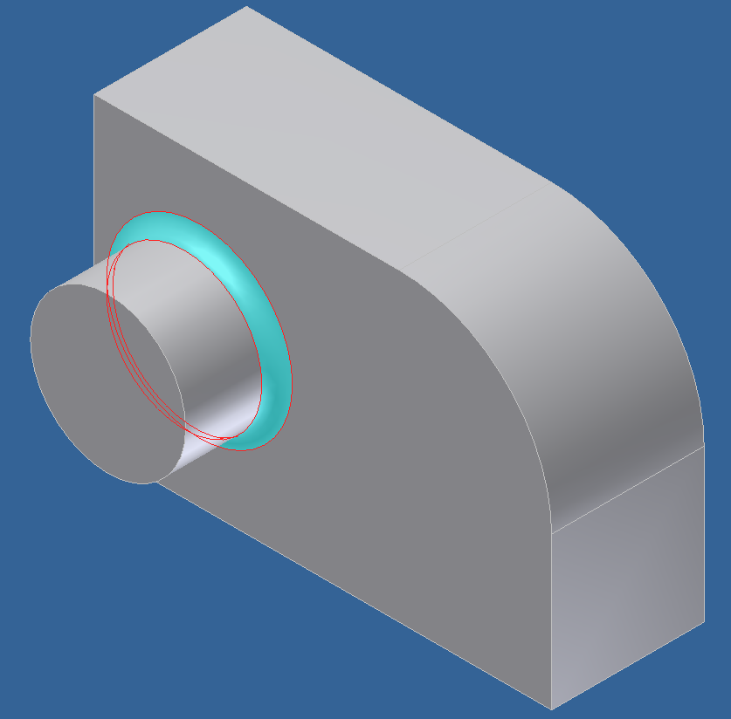
Lab: B-Rep and Features
Complete the previous lab (Part Document Lab) by finding the front face of the solid and creating a sketch.
Create an extrusion to create the cylindrical boss.
Find the edge to fillet.
Create a fillet feature.

Slide 28

Notes:
Thank you!
Questions?

